Slide 1

Project Title - Seasonal Agriculture Performance Analysis
Student Name - Dheeraj Kumar Mahto
College Name - Amity University Jharkhand
AICTE STU ID :
( STU679618ca276c61737889994 )

Slide 2

PROBLEM STATEMENT
Agricultural activities are influenced by seasonal variations in environmental conditions, farming practices, resource availability and market conditions. As a result, agricultural performance may differ from one season to another. However, raw agricultural data does not clearly explain how agricultural performance changes across seasons or what patterns can be observed in different seasonal conditions. The problem is to analyze the given agricultural dataset and investigate seasonal differences in agricultural performance by identifying meaningful patterns, trends, relationships and variations within the available data.

Slide 3
Project Description:
[ Seasonal Agriculture Performance Analysis is a data analytics project that analyzes agricultural activities across different seasons, geographical areas, and farming conditions. The project focuses on understanding how seasonal variations affect agricultural performance, including crop production, resource usage, environmental conditions, and economic outcomes.
The project involves exploring, cleaning, and preparing the agricultural dataset, followed by analyzing seasonal patterns, trends, relationships, and differences in agricultural performance. Statistical and visualization techniques are used to identify significant observations and unusual patterns.
The analysis also compares agricultural performance across different seasons and investigates relationships between seasonal environmental conditions, resource usage, and agricultural outcomes. Based on the findings, the project aims to provide data-driven insights and recommendations that can support better seasonal agricultural planning.
]

Slide 4

WHO ARE THE END USERS?
Farmers – to understand seasonal patterns and improve farming decisions.
Agricultural planners – to support seasonal agricultural planning.
Agricultural stakeholders – to understand performance, resource usage, and seasonal trends.
Decision-makers – to make evidence-based decisions based on agricultural data.

Slide 5

Technology Used
Python
Jupyter Notebook
Pandas – data cleaning and analysis
NumPy – numerical operations
Matplotlib / Seaborn – data visualization
Statistical analysis techniques

Slide 6
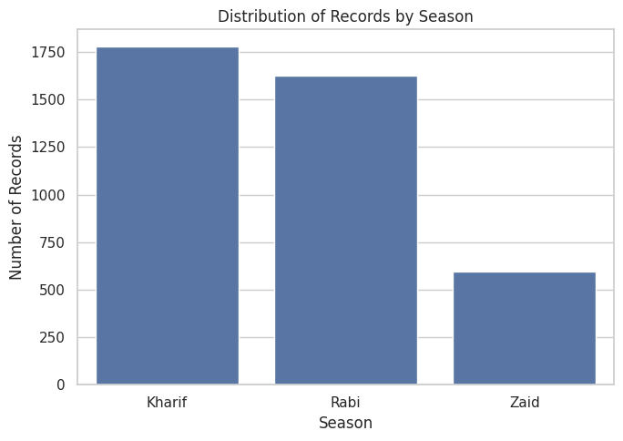
RESULTS
Result – Distribution of Records by Season
“This bar chart shows the distribution of records across the three agricultural seasons. Kharif has the highest number of records, with around 1,780 records. Rabi has around 1,620 records, while Zaid has the lowest, with around 560 records. Therefore, the dataset contains much more information about Kharif and Rabi compared to Zaid.”
Main result: Kharif > Rabi > Zaid in number of records.

Slide 7
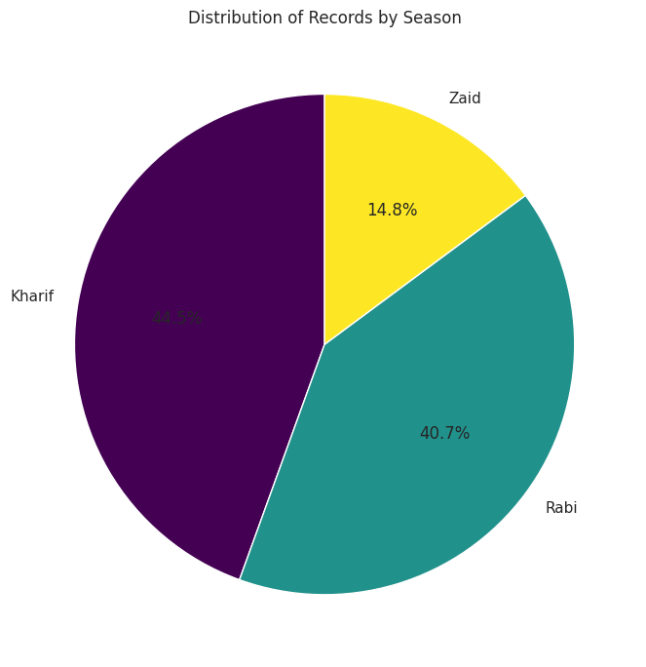
RESULTS
Result – Season Distribution (Pie Chart)
This pie chart shows the percentage distribution of records across the three seasons. Kharif has the largest share with 44.5%, followed by Rabi with about 40.7%, while Zaid has the smallest share with 14.8%. This shows that most of the data belongs to the Kharif and Rabi seasons.”
Main result: Kharif 44.5% > Rabi 40.7% > Zaid 14.8%.

Slide 8
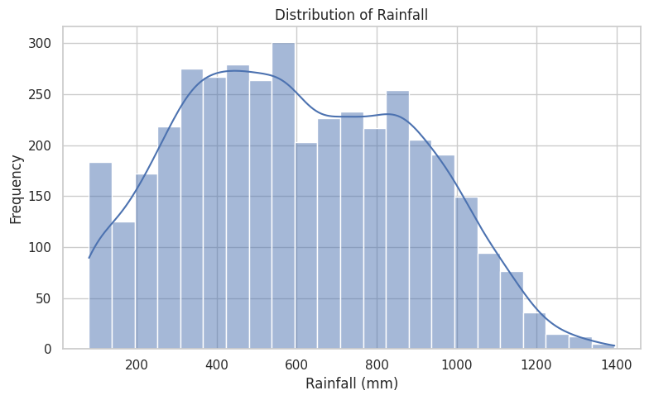
RESULTS
Result – Distribution of Rainfall
This histogram shows how rainfall is distributed in the dataset. Most of the observations are concentrated between approximately 300 and 900 mm. The highest frequency is around 500–600 mm. After around 900 mm, the frequency gradually decreases, and very high rainfall values above 1,200 mm are less common.

Slide 9
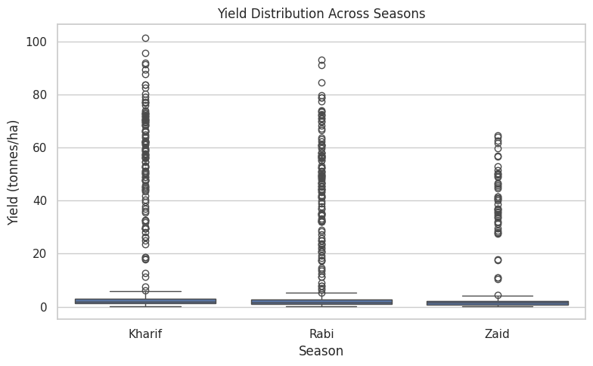
RESULTS
Result – Yield Distribution Across Seasons
This box plot compares agricultural yield across Kharif, Rabi, and Zaid seasons. Kharif has the highest overall yield distribution, followed by Rabi, while Zaid has the lowest. We can also see many points above the main boxes, which indicate unusually high yield values or potential outliers. Overall, the result suggests that yield performance is stronger in Kharif and Rabi than in Zaid.

Slide 10
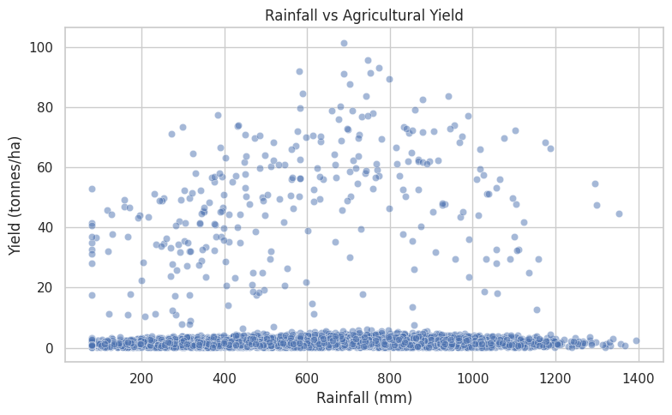
RESULTS
Result – Rainfall vs Agricultural Yield
This scatter plot shows the relationship between rainfall and agricultural yield. The points are widely scattered, so there is no clear strong relationship between rainfall and yield. Although some higher yields are seen at moderate to higher rainfall levels, increasing rainfall does not consistently increase yield. This suggests that other factors, such as crop type, irrigation, soil, and farming practices, may also have an important impact on yield.

Slide 11
Future scope
Analyze larger agricultural datasets.
Include data from more regions and seasons.
Apply advanced statistical techniques to identify deeper patterns.
Use machine learning to predict agricultural performance.
Develop interactive dashboards for easier data visualization.
Identify future seasonal trends and unusual patterns.
Improve agricultural planning using data-driven insights.
Provide better recommendations for farmers and agricultural planners.

Slide 12
GitHub Link

Slide 13

VOIS Course completion certificate -
Course name- Data Visualization

Slide 14
Thank you
.
.

